Slide 1

INTELLIGENT VEHICLE DAMAGE ASSESSMENT AND COST ESTIMATOR FOR INSURANCE COMPANIES
DHANALAKSHMI SRINIVASAN COLLEGE OF ENGINEERING AND TECHNOLOGY
MAMALLAPURAM,ECR,CHENNAI-603104
MINI PROJECT
PREPARED BY :
R.NAVEEN(310520104077)
S.NITHISH KUMAR(310520104080)
R.SIVABALA(310520104119)
Guided by:
M.PRABHAKARAN
30.05.2023
DEPARTMENT OF CSE

Slide 2
ABSTRACT
Analysis of the damaged vehicle that can be automatically claiming insurance that takes human resource, time and effort.
Image processing and machine learning techniques are analyzing the vehicle damage in the proposed solution.
In Advanced solution helps to speed up the claiming process sufficiently.
30.05.2023
DHANALAKSHMI SRINIVASAN COLLEGE OF ENGINEERING AND TECHNOLOGY DEPARTMENT OF CSE

Slide 3
INTRODUCTION
The whole idea focuses on this question: how can a customer claim insurance more quickly?
To keep the procedure quiet, a machine learning model is developed that utilizes image processing to categorize the photographs and calculate the percentage of damage to the car
30.05.2023
DHANALAKSHMI SRINIVASAN COLLEGE OF ENGINEERING AND TECHNOLOGY DEPARTMENT OF CSE

Slide 4
LITERATURE SURVEY
In 3D Computer Aided Design for the discernment of car damage from the picture, the system only detect damage at edge portion only.
VGG16 and VGG19 damaged car detection in the real world. This algorithm notices the severity of the damaged car based on the location.
Using convolution neural network is used to accept that image contains a car damage or not.
30.05.2023
DHANALAKSHMI SRINIVASAN COLLEGE OF ENGINEERING AND TECHNOLOGY DEPARTMENT OF CSE

Slide 5
EXISTING SYSTEM
In 3D Computer Aided Design for the discernment of car damage from the picture.
The deep learning-based algorithm are VGG16 and VGG19 damaged car detection in the real world.
Disadvantage:
This algorithm notices the severity of the damaged car based on the location and the system only detect damage at edge portion only
30.05.2023
DHANALAKSHMI SRINIVASAN COLLEGE OF ENGINEERING AND TECHNOLOGY DEPARTMENT OF CSE

Slide 6
PROPOSED SYSTEM
Insurance firms frequently losses because they are unable to accurately estimate the cost of damaged automobiles and they are unable to calculate the cost of damaged cars precisely, insurance companies regularly incurred losses.
Problem Statement (Problem to be solved)
Car damage is automatically identified and classified using Deep Learning and pattern recognition technology.
Idea / Solution description
It can be used by insurance companies for faster processing of claims and can also be used to underwriting a car loan, especially for a used car.
Scalability of the solution
30.05.2023
DHANALAKSHMI SRINIVASAN COLLEGE OF ENGINEERING AND TECHNOLOGY DEPARTMENT OF CSE

Slide 7
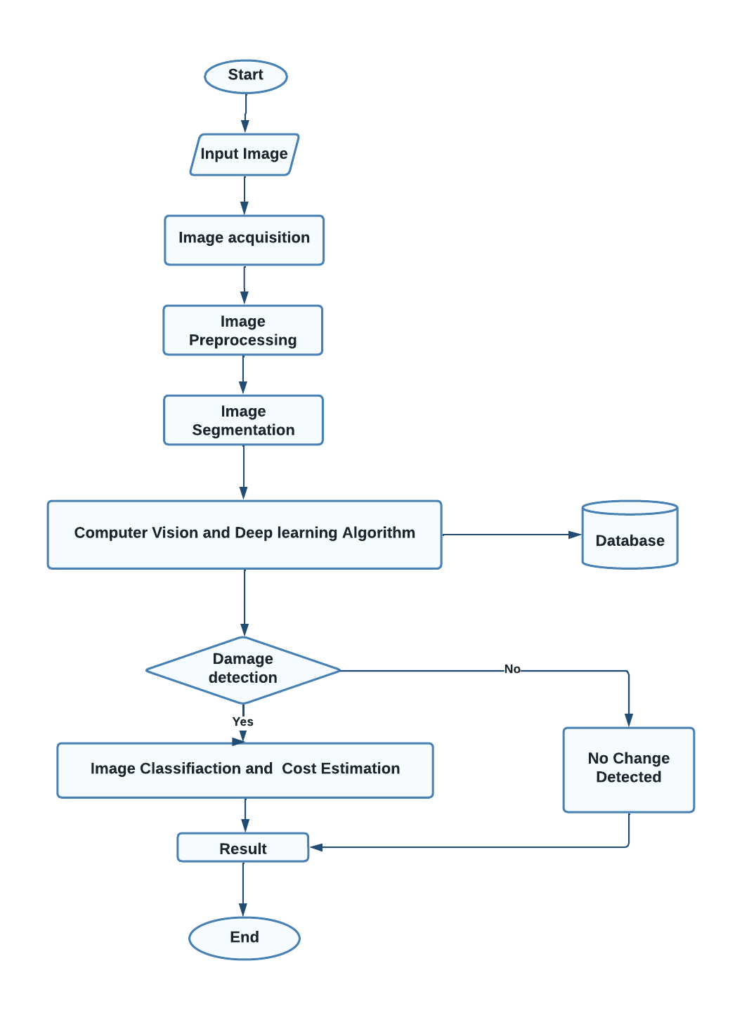
FLOWCHART
30.05.2023
DHANALAKSHMI SRINIVASAN COLLEGE OF ENGINEERING AND TECHNOLOGY DEPARTMENT OF CSE

Slide 8
USED TECHNOLOGIES
OPERATING SYSTEM : Windows 7/XP/8/10/11/12
FRONT END : HTML, CSS, JAVASCRIPT
SERVER SIDE SCRIPT : Python
DATABASE : MongoDB
30.05.2023
DHANALAKSHMI SRINIVASAN COLLEGE OF ENGINEERING AND TECHNOLOGY DEPARTMENT OF CSE

Slide 9
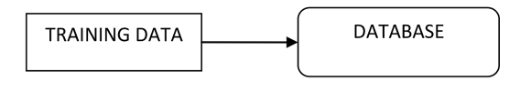
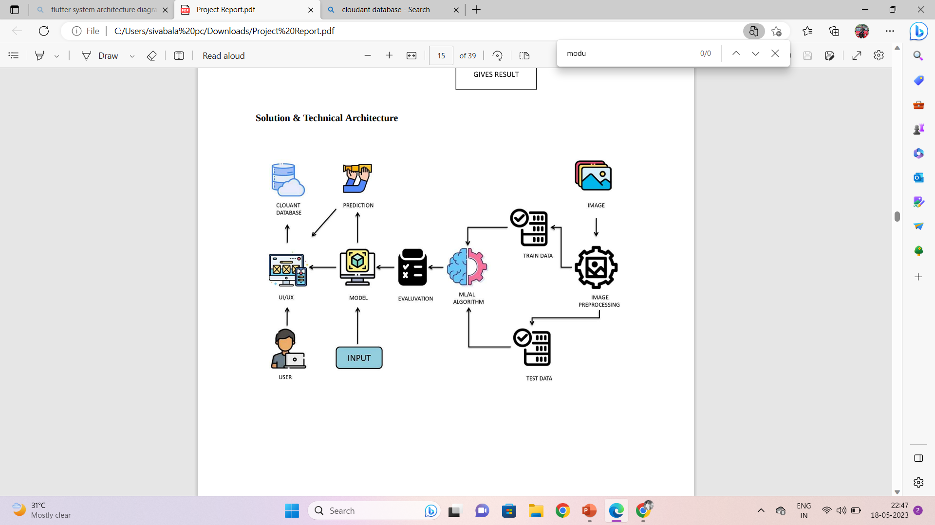
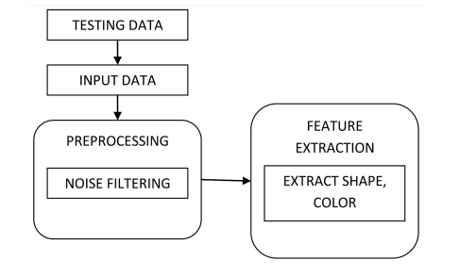
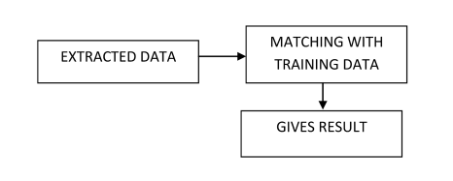
SYSTEM ARCHITECTURE
Level 0
Level 1
Level 2
30.05.2023
DHANALAKSHMI SRINIVASAN COLLEGE OF ENGINEERING AND TECHNOLOGY DEPARTMENT OF CSE

Slide 10
Level 0
Level 1
Level 2
The Level 0 DFD shows how the system is divided into 'sub-systems' (processes), each of which deals with one or more of the data flows to or from an external agent, and which together provide all of the functionality of the system as a whole. It also identifies internal data stores that must be present in order for the system to do its job, and shows the flow of data between the various parts of the system.
The next stage is to create the Level 1 Data Flow Diagram. This highlights the main functions carried out by the system. As a rule, to describe the system was using between two and seven functions - two being a simple system and seven being a complicated system. This enables us to keep the model manageable on screen or paper.
A Data Flow Diagram (DFD) tracks processes and their data paths within the business or system boundary under investigation. A DFD defines each domain boundary and illustrates the logical movement and transformation of data within the defined boundary
30.05.2023
DHANALAKSHMI SRINIVASAN COLLEGE OF ENGINEERING AND TECHNOLOGY DEPARTMENT OF CSE

Slide 11
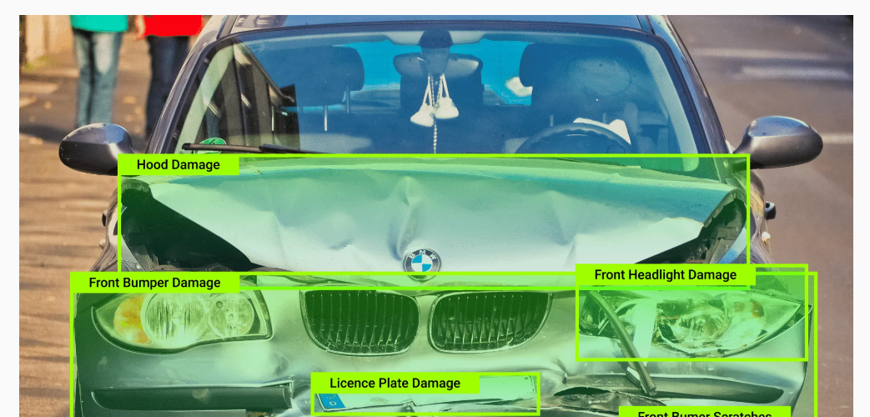
PRE-PROCESSING
After upload the image ,It pre-process the given input to identify the damaged parts and calculate the required amount
30.05.2023
DHANALAKSHMI SRINIVASAN COLLEGE OF ENGINEERING AND TECHNOLOGY DEPARTMENT OF CSE

Slide 12


HOME PAGE
PREDECTION PAGE
30.05.2023
DHANALAKSHMI SRINIVASAN COLLEGE OF ENGINEERING AND TECHNOLOGY DEPARTMENT OF CSE

Slide 13
MODULES
User Login
Upload Image
Damage Analysis
Cost Estimation
30.05.2023
DHANALAKSHMI SRINIVASAN COLLEGE OF ENGINEERING AND TECHNOLOGY DEPARTMENT OF CSE

Slide 14
User Login:
The Login Module is a portal module that allows users to type a user name and password to log in. You can add this module on any module tab to allow users to log in to the system.
Upload Image:
A module where users can upload their vehicle damaged images.
Damage Analysis:
Damage analysis module is used to detect the damages from the uploaded images.
Cost Estimation:
A module where calculate the cost for damaged parts from the damage analysis.
30.05.2023
DHANALAKSHMI SRINIVASAN COLLEGE OF ENGINEERING AND TECHNOLOGY DEPARTMENT OF CSE

Slide 15
CONCLUSION
In this proposed project, a neural network-based solution for car detection; manage the problem of car damage analysis, prediction of car damage location and severity of the damage.
The system will definitely help the insurance companies to analyze the car damage a lot more successful and well organized.
FUTURE SCOPE
In future ,We will add more features like live camera detection, car selling, insurance claim, old car collection and car modification. It will help customer to find all the services on the same application.
30.05.2023
DHANALAKSHMI SRINIVASAN COLLEGE OF ENGINEERING AND TECHNOLOGY DEPARTMENT OF CSE

Slide 16
REFERENCES
A.Neela Madheswari, J.haripriya, G.Kiruthika, R.M.Meyammai Mahendra Engineering college, India, exterior vehicular damage detection using deep learning, department of computer science and engineering.
Girish N, Mohammed Aqeel Arshad, car damage detection using machine learning. International journal of advances research in computer and communication engineering, Vol. 10, issue 8, August 2021 DOI 10.17148/IJARCCE.2021.10808.
Phyu Mar Kyu, car damage detection and classification, faculty of information technology king Mongkut’s institute of technology ladkrabang Bangkok, Thailand 62606003@kmitl.ac.in.
S. Jayawardena, Image based automatic vehicle damage detection. PhD thesis, College of Engineering and Computer Science (CECS), 12 2013.
S. Gontscharov, H Baumgartel, A.Kneifel, and K.-L. Krieger, Algorithm development for minor damage identification in vehicle bodies using adaptive sensor data processing," Procedia Technology, vol. 15, pp. 586 594, 2014. 2nd International Conference on System-Integrated Intelligence: Challenges for Product and Production Engineering.
Y.J. Cha, J. Chen, and O. B’’uy’’uk’’ozt’’urk, Output-only computer visionbased damage detection using phase-based optical flow and unscented kalman lters," Engineering Structures, vol. 132, pp. 300, {313, 2017
30.05.2023
DHANALAKSHMI SRINIVASAN COLLEGE OF ENGINEERING AND TECHNOLOGY DEPARTMENT OF CSE

Slide 17
THANK YOU
30.05.2023
DHANALAKSHMI SRINIVASAN COLLEGE OF ENGINEERING AND TECHNOLOGY DEPARTMENT OF CSE

